Slide 1




Crochet
Design
Collection
A.B.M.Chamudi Upeksha Basnayaka
RAT/IT/2324/F/0080

Slide 2

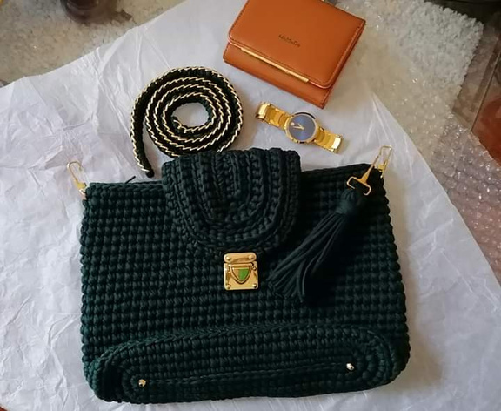
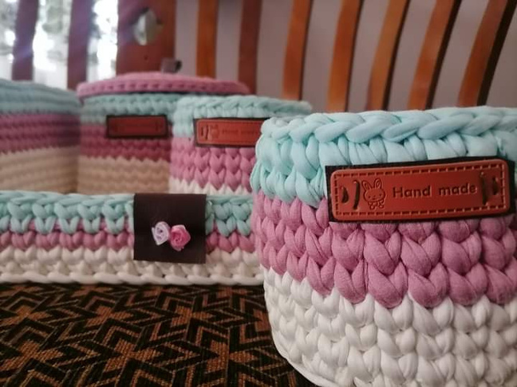



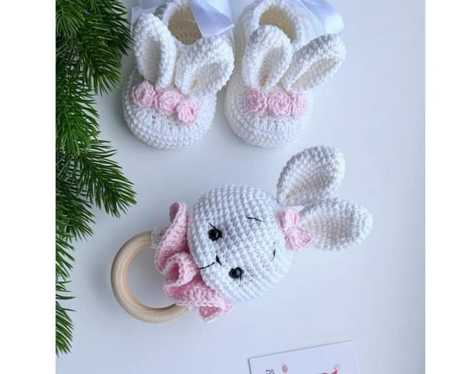
CONTENT...
MISSION
Project Concept
Our mission is to empower organizations to thrive through strategic guidance, innovative solutions, and unparalleled expertise.
Planning and Organization
Technical Skills
VISION
We aim to push boundaries using advanced tech for transformative solutions.
Completeness

Slide 3

Project Concept...
"Creating an online platform to explore and purchase unique, handcrafted crochet designs made from eco-friendly materials, promoting environmentally conscious and eco-friendly living."
Planning and Organization...
Time Line
ER Diagram
Wireframe
Budget Plan

Slide 4








Technical Skill...
1. MS Office Package
MS Word
MS Excel
MS Access
MS PowerPoint
2. Ecwid
3. Canva
4. Draw oi
5. Figma

Slide 5

Completeness…
Go To Database
Go to Database System
Go To Web Site

Slide 6
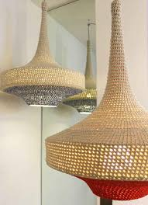
Thank You....

